Slide 1
Chicago Clojure Meetup
Researching “third way” democratically-run economies with Clojure(script)
Mitchell Szczepanczyk
October 28, 2021
http://www.szcz.org
https://www.meetup.com/ChicagoClj/

Slide 2
Summary of topics
Mathematics
Economics
Computer code (not Clojure)
20th century history of economies
History of ideas
Clojure
Clojurescript

Slide 3
OutlinE
A Clojure story
Economies and problems
A “third way”
Algorithm and code
pequod-cljs
pequod-clj
Future directions

Slide 4
OutlinE
A Clojure story
Economies and problems
A “third way”
Algorithm and code
pequod-cljs
pequod-clj
Future directions

Slide 5
A Clojure story

Slide 6
A Clojure story

Slide 7
A Clojure story

Slide 8
A Clojure story

Slide 9
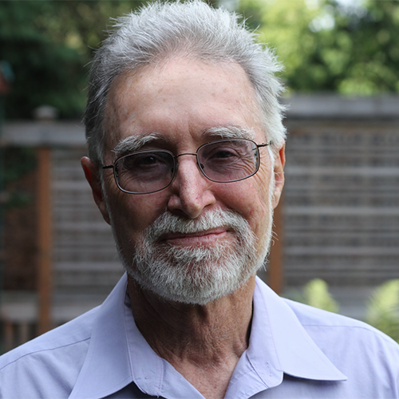
A Clojure story

Slide 10
A Clojure story

Slide 11
A Clojure story

Slide 12
A Clojure story

Slide 13
A Clojure story

Slide 14
A Clojure story

Slide 15
A Clojure story

Slide 16
A Clojure story

Slide 17
A Clojure story

Slide 18
A Clojure story

Slide 19
A Clojure story

Slide 20
OutlinE
A Clojure story
Economies and problems
A “third way”
Algorithm and code
pequod-cljs
pequod-clj
Future directions

Slide 21
Economies and problems

Slide 22
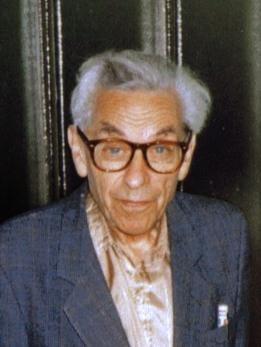
Economies and problems
Paul Erdős

Slide 23
Economies and problems

Slide 24
Economies and problems

Slide 25
Economies and problems

Slide 26
Economies and problems

Slide 27
Economies and problems

Slide 28
Economies and problems
Allocation

Slide 29
Economies and problems
Allocation | Markets

Slide 30
Economies and problems
Allocation | Markets | Command/central planning

Slide 31
Economies and problems
Allocation | Markets | Command/central planning
“Sovereign”

Slide 32
Economies and problems
Allocation | Markets | Command/central planning
“Sovereign” | Limited-liability corporation

Slide 33
Economies and problems
Allocation | Markets | Command/central planning
“Sovereign” | Limited-liability corporation | Command-planning authority

Slide 34
Economies and problems
Allocation | Markets | Command/central planning
“Sovereign” | Limited-liability corporation | Command-planning authority
Income

Slide 35
Economies and problems
Allocation | Markets | Command/central planning
“Sovereign” | Limited-liability corporation | Command-planning authority
Income | Market power and contribution of human and physical capital to output

Slide 36
Economies and problems
Allocation | Markets | Command/central planning
“Sovereign” | Limited-liability corporation | Command-planning authority
Income | Market power and contribution of human and physical capital to output | Contribution of human capital to output

Slide 37
Economies and problems
Allocation | Markets | Command/central planning
“Sovereign” | Limited-liability corporation | Command-planning authority
Income | Market power and contribution of human and physical capital to output | Contribution of human capital to output
Division of Labor

Slide 38
Economies and problems
Allocation | Markets | Command/central planning
“Sovereign” | Limited-liability corporation | Command-planning authority
Income | Market power and contribution of human and physical capital to output | Contribution of human capital to output
Division of Labor | Hierarchial | Hierarchical

Slide 39
Economies and problems
Dictatorial dynamic

Slide 40
Economies and problems
Dictatorial dynamic
Monopoly of information by conceptual workers

Slide 41
Economies and problems
Dictatorial dynamic
Monopoly of information by conceptual workers
Inefficient for addressing human outcomes

Slide 42
Economies and problems
Dictatorial dynamic
Monopoly of information by conceptual workers
Inefficient for addressing human outcomes
Obstructs self-management

Slide 43
Economies and problems
Dictatorial dynamic
Monopoly of information by conceptual workers
Inefficient for addressing human outcomes
Obstructs self-management
“Impossible to calculate”

Slide 44
Economies and problems

Slide 45
Economies and problems
Antagonistic roles

Slide 46
Economies and problems
Antagonistic roles
Workplace hierarchy

Slide 47
Economies and problems
Antagonistic roles
Workplace hierarchy
No collective consumption

Slide 48
Economies and problems
Antagonistic roles
Workplace hierarchy
No collective consumption
Pervasive externalities

Slide 49
Economies and problems
Antagonistic roles
Workplace hierarchy
No collective consumption
Pervasive externalities
Inefficient

Slide 50
Economies and problems

Slide 51
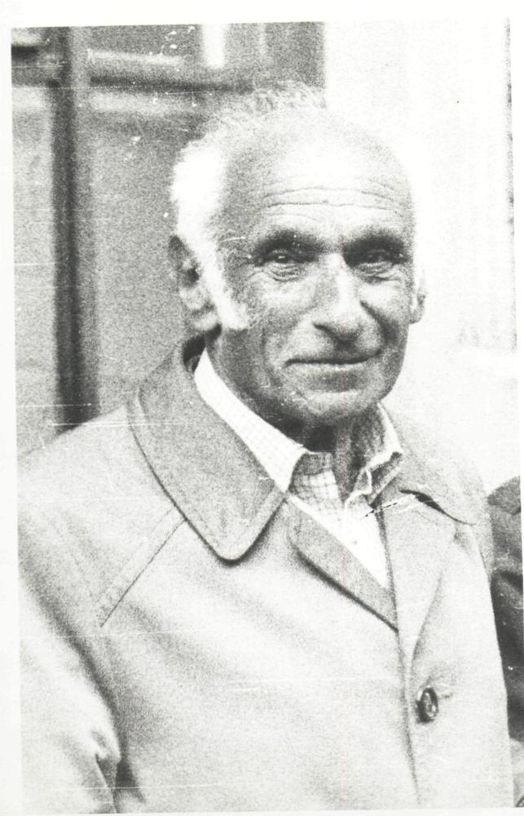
Economies and problems
Alec Nove

Slide 52
Economies and problems
“In a complex industrial economy, the interrelation between its parts can be based in principle either on freely chosen negotiated contracts [i.e., markets], or on a system of binding instructions from planning offices [i.e., central planning]. There is no third way.” – Alec Nove

Slide 53
Economies and problems

Slide 54
OutlinE
A Clojure story
Economies and problems
A “third way”
Algorithm and code
pequod-cljs
pequod-clj
Future directions

Slide 55
A “third way”

Slide 56
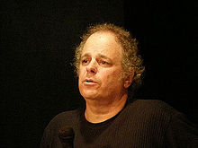
A “third way”
Robin Hahnel
Michael Albert

Slide 57
A “third way”

Slide 58
A “third way”
Democratic Planning

Slide 59
A “third way”
Democratic Planning
Participatory Economics

Slide 60
A “third way”
Democratic Planning
Participatory Economics
Participatory Economy

Slide 61
A “third way”
Allocation | Markets | Command/central planning
“Sovereign” | Limited-liability corporation | Command-planning authority
Income | Market power and contribution of human and physical capital to output | Contribution of human capital to output
Division of Labor | Hierarchial | Hierarchical

Slide 62
A “third way”
Allocation | Markets | Command/central planning
“Sovereign” | Limited-liability corporation | Command-planning authority
Income | Market power and contribution of human and physical capital to output | Contribution of human capital to output
Division of Labor | Hierarchical | Hierarchical

Slide 63
A “third way”
 |  |  | Participatory Economy
Allocation | Markets | Command/central planning
“Sovereign” | Limited-liability corporation | Command-planning authority
Income | Market power and contribution of human and physical capital to output | Contribution of human capital to output
Division of Labor | Hierarchical | Hierarchical

Slide 64
A “third way”
 |  |  | Participatory Economy
Allocation | Markets | Command/central planning
“Sovereign” | Limited-liability corporation | Command-planning authority
Income | Market power and contribution of human and physical capital to output | Contribution of human capital to output
Division of Labor | Hierarchical | Hierarchical | Balanced jobs

Slide 65
A “third way”
 |  |  | Participatory Economy
Allocation | Markets | Command/central planning
“Sovereign” | Limited-liability corporation | Command-planning authority
Income | Market power and contribution of human and physical capital to output | Contribution of human capital to output | Effort and sacrifice in socially valued labor, tempered by need
Division of Labor | Hierarchical | Hierarchical | Balanced jobs

Slide 66
A “third way”
 |  |  | Participatory Economy
Allocation | Markets | Command/central planning
“Sovereign” | Limited-liability corporation | Command-planning authority | Worker and consumer councils
Income | Market power and contribution of human and physical capital to output | Contribution of human capital to output | Effort and sacrifice in socially valued labor, tempered by need
Division of Labor | Hierarchical | Hierarchical | Balanced jobs

Slide 67
A “third way”
 |  |  | Participatory Economy
Allocation | Markets | Command/central planning | Participatory planning
“Sovereign” | Limited-liability corporation | Command-planning authority | Worker and consumer councils
Income | Market power and contribution of human and physical capital to output | Contribution of human capital to output | Effort and sacrifice in socially valued labor, tempered by need
Division of Labor | Hierarchical | Hierarchical | Balanced jobs

Slide 68
A “third way”
Participatory planning: Non-market, non-command planning allocation system used in a participatory economy

Slide 69
A “third way”
Participatory planning: Non-market, non-command planning allocation system used in a participatory economy
Brief description: Councils propose plans, then revise those plans in a series of iterations, until excess demand is eliminated.

Slide 70
A “third way”
Participatory Planning: Participants

Slide 71
A “third way”
Participatory Planning: Participants
Workers councils and federations

Slide 72
A “third way”
Participatory Planning: Participants
Workers councils and federations
Consumer councils and federations

Slide 73
A “third way”
Participatory Planning: Participants
Workers councils and federations
Consumer councils and federations
Iteration Facilitation Board (IFB)

Slide 74
A “third way”
Participatory Planning: Participants
Workers councils and federations
Consumer councils and federations
Iteration Facilitation Board (IFB)
Participatory Planning: Procedure

Slide 75
A “third way”
Participatory Planning: Participants
Workers councils and federations
Consumer councils and federations
Iteration Facilitation Board (IFB)
Participatory Planning: Procedure
IFB announces “indicative prices” (best indicators of social and opportunity costs)

Slide 76
A “third way”
Participatory Planning: Participants
Workers councils and federations
Consumer councils and federations
Iteration Facilitation Board (IFB)
Participatory Planning: Procedure
IFB announces “indicative prices” (best indicators of social and opportunity costs)
Consumer councils make consumption proposals

Slide 77
A “third way”
Participatory Planning: Participants
Workers councils and federations
Consumer councils and federations
Iteration Facilitation Board (IFB)
Participatory Planning: Procedure
IFB announces “indicative prices” (best indicators of social and opportunity costs)
Consumer councils make consumption proposals
Worker councils make production proposals

Slide 78
A “third way”
Participatory Planning: Participants
Workers councils and federations
Consumer councils and federations
Iteration Facilitation Board (IFB)
Participatory Planning: Procedure
IFB announces “indicative prices” (best indicators of social and opportunity costs)
Consumer councils make consumption proposals
Worker councils make production proposals
IFB adjusts prices based on demands and supplies

Slide 79
A “third way”
Participatory Planning: Participants
Workers councils and federations
Consumer councils and federations
Iteration Facilitation Board (IFB)
Participatory Planning: Procedure
IFB announces “indicative prices” (best indicators of social and opportunity costs)
Consumer councils make consumption proposals
Worker councils make production proposals
IFB adjusts prices based on demands and supplies
Repeat until there’s no excess demand

Slide 80
A “third way”
“After publication, critics suddenly dropped the objection that participatory planning is technically impossible and raised new objections.” – Robin Hahnel

Slide 81
A “third way”
“After publication, critics suddenly dropped the objection that participatory planning is technically impossible and raised new objections.” – Robin Hahnel
The practicality question: How many iterations would a participatory planning procedure require to arrive at a feasible plan?

Slide 82
OutlinE
A Clojure story
Economies and problems
A “third way”
Algorithm and code
pequod-cljs
pequod-clj
Future directions

Slide 83
Algorithm and code

Slide 84
Algorithm and code
Simulate an economy with consumers and producers

Slide 85
Algorithm and code
Simulate an economy with consumers and producers
Production and utility functions

Slide 86
Algorithm and code
Simulate an economy with consumers and producers
Production and utility functions
Cobb Douglas

Slide 87
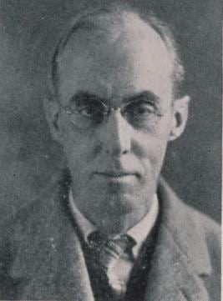
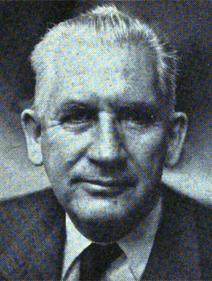
Algorithm and code
Charles Cobb
Paul Douglas

Slide 88
Algorithm and code
Cobb Douglas production function, simplified abstract form:

Slide 89
Algorithm and code
Cobb Douglas production function, simplified abstract form:
Y = AL^{β}K^{α}

Slide 90
Algorithm and code
Cobb Douglas production function, simplified abstract form:
Y = AL^{β}K^{α}
Y = output

Slide 91
Algorithm and code
Cobb Douglas production function, simplified abstract form:
Y = AL^{β}K^{α}
Y = output
L = labor input

Slide 92
Algorithm and code
Cobb Douglas production function, simplified abstract form:
Y = AL^{β}K^{α}
Y = output
L = labor input
K = capital input

Slide 93
Algorithm and code
Cobb Douglas production function, simplified abstract form:
Y = AL^{β}K^{α}
Y = output
L = labor input
K = capital input
α, β = output elasticities

Slide 94
Algorithm and code
Cobb Douglas production function, simplified abstract form:
Y = AL^{β}K^{α}
Y = output
L = labor input
K = capital input
α, β = output elasticities
A = total factor of productivity

Slide 95
Algorithm and code
Adapted production function for a simulation of a participatory planning procedure:

Slide 96
Algorithm and code
Adapted production function for a simulation of a participatory planning procedure:
z = qxªr^{b}l^{c}e^{d}

Slide 97
Algorithm and code
Adapted production function for a simulation of a participatory planning procedure:
z = qxªr^{b}l^{c}e^{d}
z = output

Slide 98
Algorithm and code
Adapted production function for a simulation of a participatory planning procedure:
z = qxªr^{b}l^{c}e^{d}
z = output
x = intermediate goods

Slide 99
Algorithm and code
Adapted production function for a simulation of a participatory planning procedure:
z = qxªr^{b}l^{c}e^{d}
z = output
x = intermediate goods
r = natural resources

Slide 100
Algorithm and code
Adapted production function for a simulation of a participatory planning procedure:
z = qxªr^{b}l^{c}e^{d}
z = output
x = intermediate goods
r = natural resources
l = kinds of labor

Slide 101
Algorithm and code
Adapted production function for a simulation of a participatory planning procedure:
z = qxªr^{b}l^{c}e^{d}
z = output
x = intermediate goods
r = natural resources
l = kinds of labor
e = effort level

Slide 102
Algorithm and code
Adapted production function for a simulation of a participatory planning procedure:
z = qxªr^{b}l^{c}e^{d}
z = output
x = intermediate goods
r = natural resources
l = kinds of labor
e = effort level
a, b, c, d = elasticities

Slide 103
Algorithm and code
Adapted production function for a simulation of a participatory planning procedure:
z = qxªr^{b}l^{c}e^{d}
z = output
x = intermediate goods
r = natural resources
l = kinds of labor
e = effort level
a, b, c, d = elasticities
q = total factor of productivity

Slide 104
Algorithm and code
Adapted production function for a simulation of a participatory planning procedure:
z = qxªr^{b}l^{c}e^{d}
z = output
x = intermediate goods
r = natural resources
l = kinds of labor
e = effort level
a, b, c, d = elasticities
q = total factor of productivity

Slide 105
Algorithm and code
Goal: Compute the well-being of a workplace.
WB (x, r, l, e) = (p_{z}qxªr^{b}l^{c}e^{d} – (p_{x}x + p_{r}r + p_{l}l)) - e^{f}
WB = well-being
x = intermediate goods
r = natural resources
l = kinds of labor
e = effort level
a, b, c, d, f = elasticities
q = total factor of productivity
p = indicative prices

Slide 106
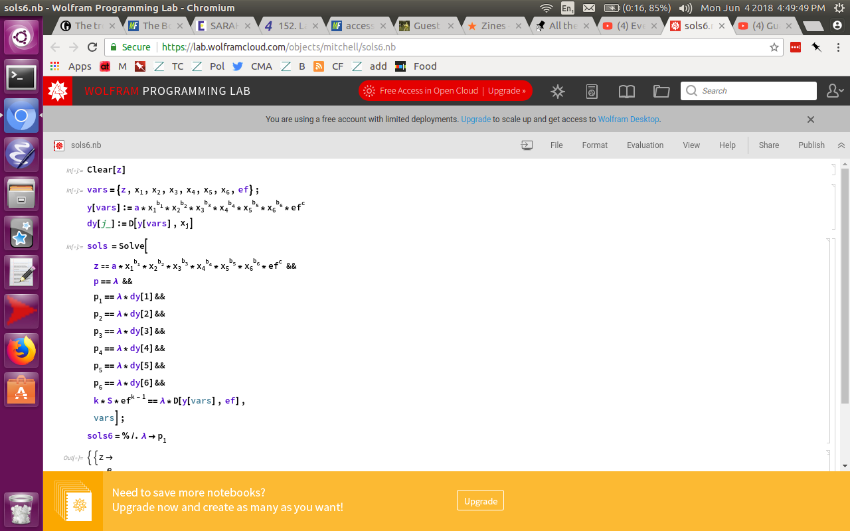
Algorithm and code

Slide 107
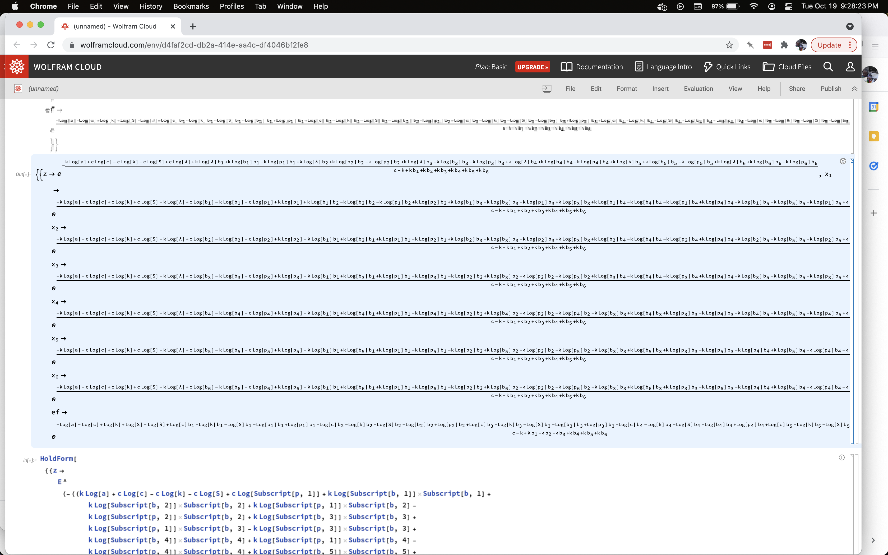
Algorithm and code

Slide 108
Algorithm and code
Adapted utility function for a simulation of a participatory planning procedure:

Slide 109
Algorithm and code
Adapted utility function for a simulation of a participatory planning procedure:
WB (y1, y2) = y₁^{α} y₂ ^{β}
subject to I_{cc} = p_{y1}y₁^{α} + p_{y2}y₂ ^{β}

Slide 110
Algorithm and code
Adapted utility function for a simulation of a participatory planning procedure:
WB (y1, y2) = y₁^{α} y₂ ^{β}
subject to I_{cc} = p_{y1}y₁^{α} + p_{y2}y₂ ^{β}
y1 = private goods consumed
y2 = public goods consumed
α, β = elasticities
p = indicative prices
I = income

Slide 111
Algorithm and code
The algorithm:

Slide 112
Algorithm and code
The algorithm:
Load WCs, CCs, indicative prices into memory.

Slide 113
Algorithm and code
The algorithm:
Load WCs, CCs, indicative prices into memory.
For each WC: Solve its optimization problem -- update its output, effort, and demands for inputs based on latest indicative prices.

Slide 114
Algorithm and code
The algorithm:
Load WCs, CCs, indicative prices into memory.
For each WC: Solve its optimization problem -- update its output, effort, and demands for inputs based on latest indicative prices.
For each CC: Solve its optimization problem – update its demands for public and private goods based on latest indicative prices.

Slide 115
Algorithm and code
The algorithm:
Load WCs, CCs, indicative prices into memory.
For each WC: Solve its optimization problem -- update its output, effort, and demands for inputs based on latest indicative prices.
For each CC: Solve its optimization problem – update its demands for public and private goods based on latest indicative prices.
Calculate the new excess demands for all goods, natural resources, and categories of labor, and apply price adjustment formula to update all indicative prices.

Slide 116
Algorithm and code
The algorithm:
Load WCs, CCs, indicative prices into memory.
For each WC: Solve its optimization problem -- update its output, effort, and demands for inputs based on latest indicative prices.
For each CC: Solve its optimization problem – update its demands for public and private goods based on latest indicative prices.
Calculate the new excess demands for all goods, natural resources, and categories of labor, and apply price adjustment formula to update all indicative prices.
Increase iteration counter by one.

Slide 117
Algorithm and code
The algorithm:
Load WCs, CCs, indicative prices into memory.
For each WC: Solve its optimization problem -- update its output, effort, and demands for inputs based on latest indicative prices.
For each CC: Solve its optimization problem – update its demands for public and private goods based on latest indicative prices.
Calculate the new excess demands for all goods, natural resources, and categories of labor, and apply price adjustment formula to update all indicative prices.
Increase iteration counter by one.
Check all excess demands. Do they fall within the specified threshold? If so, stop. If not, go to step 1 and repeat.

Slide 118
Algorithm and code
Price adjustment formula:

Slide 119
Algorithm and code
Price adjustment formula:
w = v(1.05 – 0.5^{v}),
except when v > 0.25 then v_{coefficient} = 0.25

Slide 120
Algorithm and code
Price adjustment formula:
w = v(1.05 – 0.5^{v}),
except when v > 0.25 then v_{coefficient} = 0.25
w = percentage change in the price of a good for the next iteration
v = percentage excess supply for a good in the iteration just completed

Slide 121
Algorithm and code
Netlogo: “a multi-agent programmable modeling environment”

Slide 122
Algorithm and code
Netlogo: “a multi-agent programmable modeling environment”
https://ccl.northwestern.edu/netlogo/

Slide 123
Algorithm and code
Netlogo: “a multi-agent programmable modeling environment”
https://ccl.northwestern.edu/netlogo/
Pros:
Easy to learn
Has a lot of built-in functions
Easy to adapt
Lots of sample tutorials
Ample documentation
Easy to iterate (“tick”)

Slide 124
Algorithm and code
Netlogo: “a multi-agent programmable modeling environment”
https://ccl.northwestern.edu/netlogo/
Pros:
Easy to learn
Has a lot of built-in functions
Easy to adapt
Lots of sample tutorials
Ample documentation
Easy to iterate (“tick”)
Cons:
Netlogo code is locked in to the Netlogo platform
Agent-based modeling; not a general programming language
Doesn’t easily scale

Slide 125
Algorithm and code
Participatory Planning Procedure Prototype (PPPP, Pequod)

Slide 126
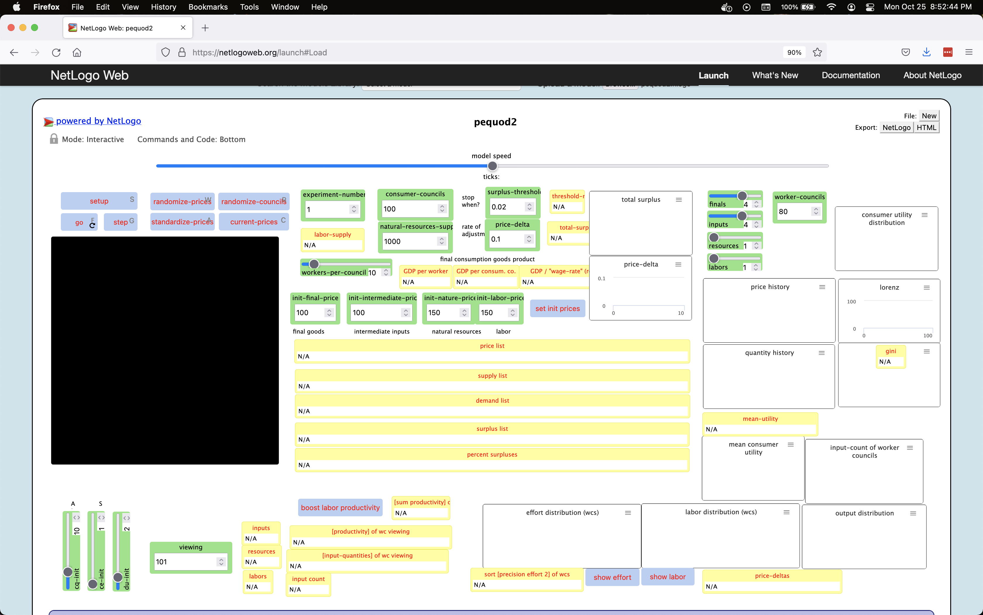
Algorithm and code
Participatory Planning Procedure Prototype (PPPP, Pequod)

Slide 127
OutlinE
A Clojure story
Economies and problems
A “third way”
Algorithm and code
pequod-cljs
pequod-clj
Future directions

Slide 128
pequod-cljs
Why switch to Clojure(script)?

Slide 129
pequod-cljs
Why switch to Clojure(script)?
Reduce mental overhead, to avoid relearning / deciphering Netlogo all the time

Slide 130
pequod-cljs
Why switch to Clojure(script)?
Reduce mental overhead, to avoid relearning / deciphering Netlogo all the time
Greater flexibility

Slide 131
pequod-cljs
Why switch to Clojure(script)?
Reduce mental overhead, to avoid relearning / deciphering Netlogo all the time
Greater flexibility
It’s more fun!

Slide 132
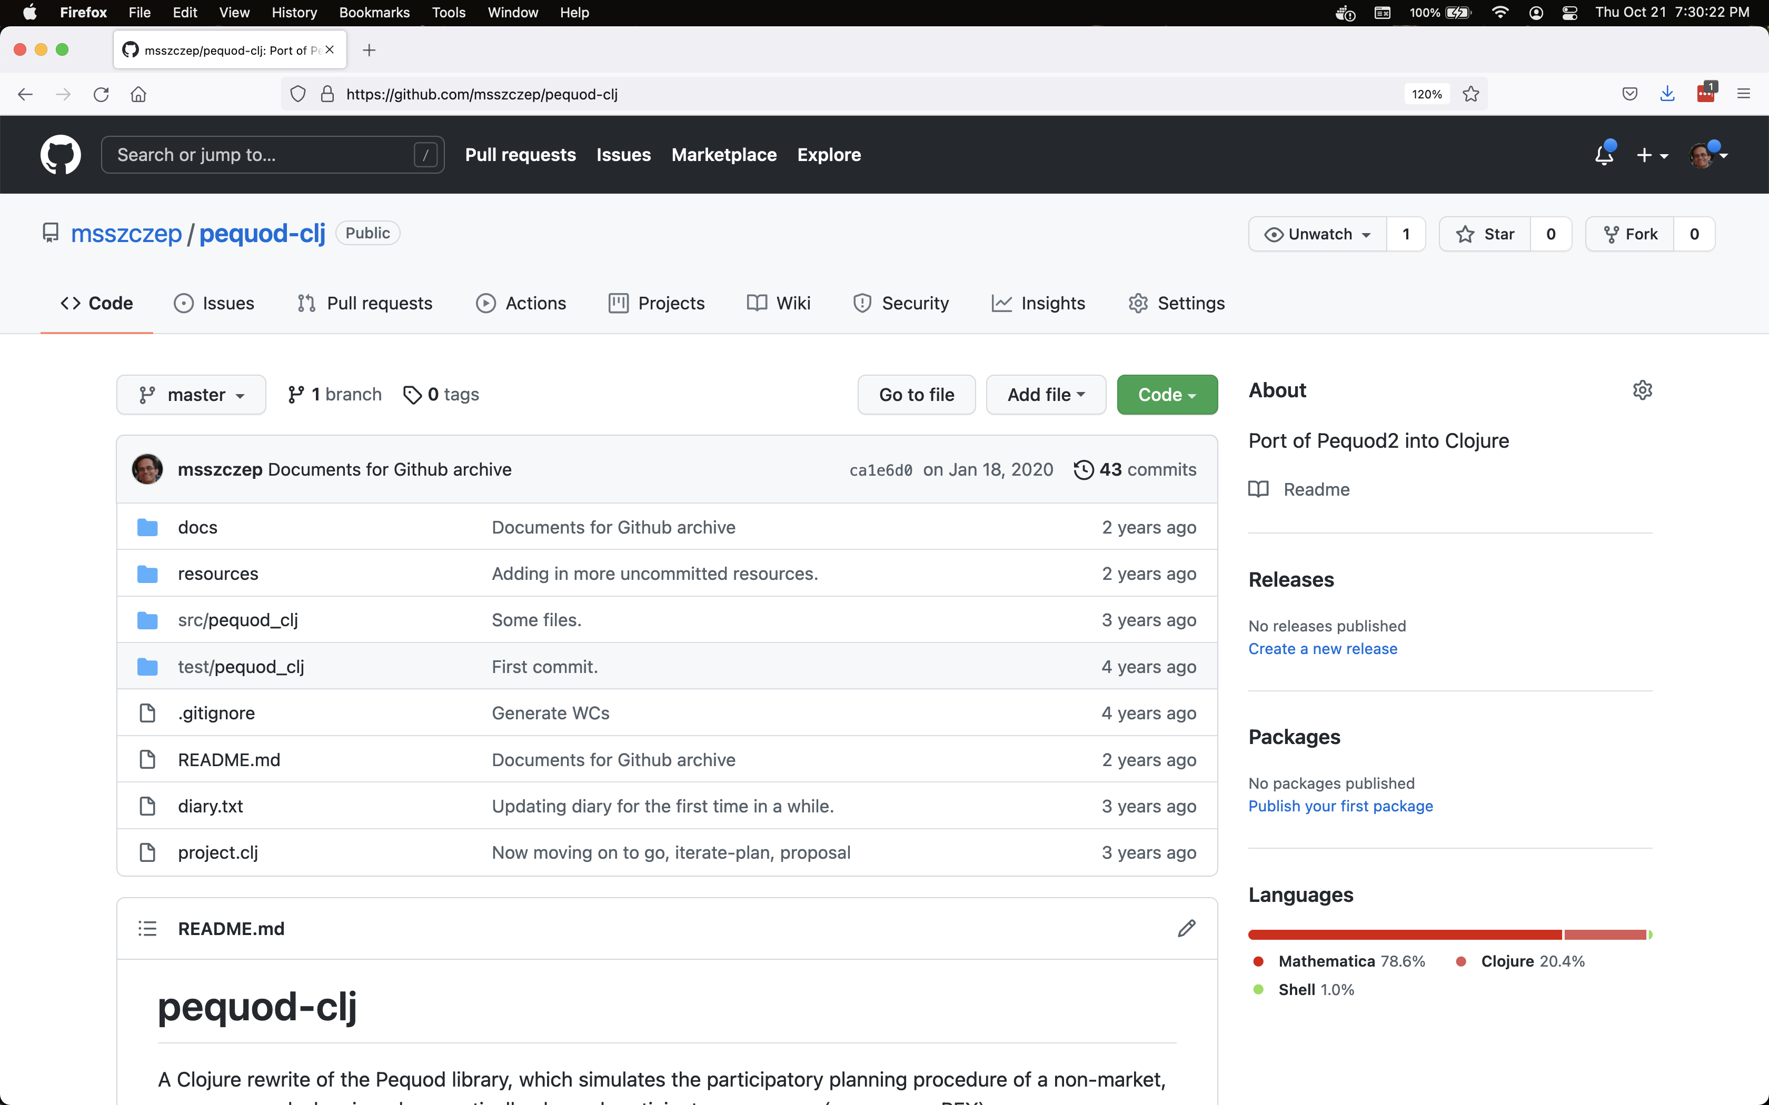
pequod-cljs

Slide 133
pequod-cljs

Slide 134
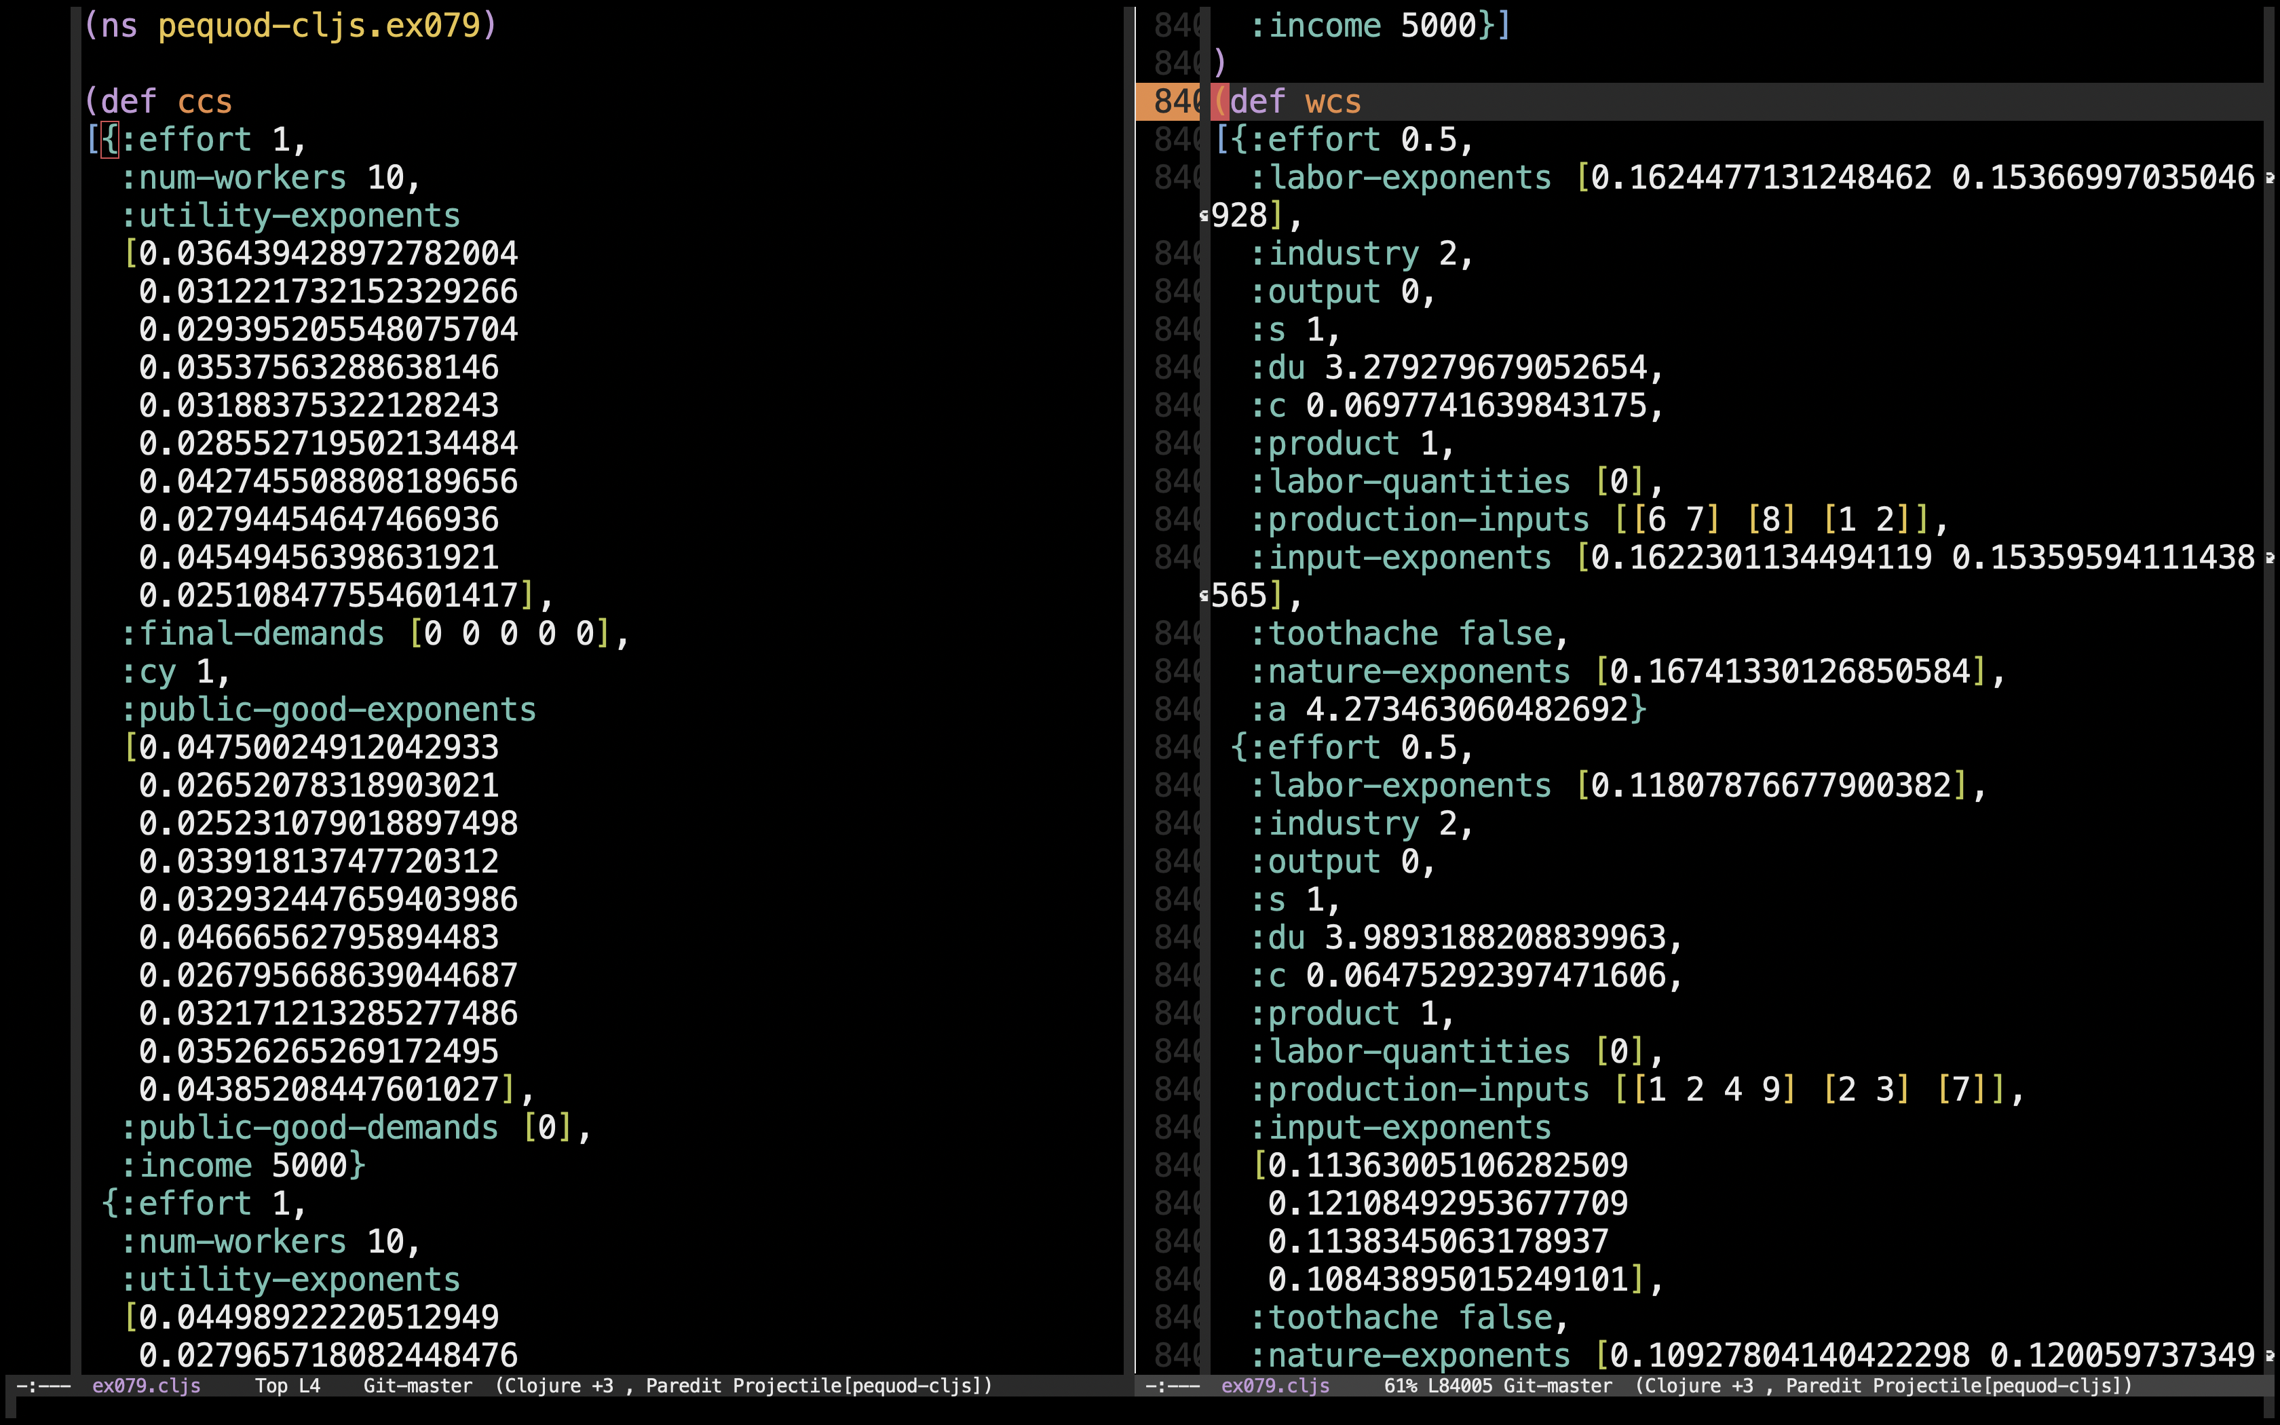
pequod-cljs

Slide 135
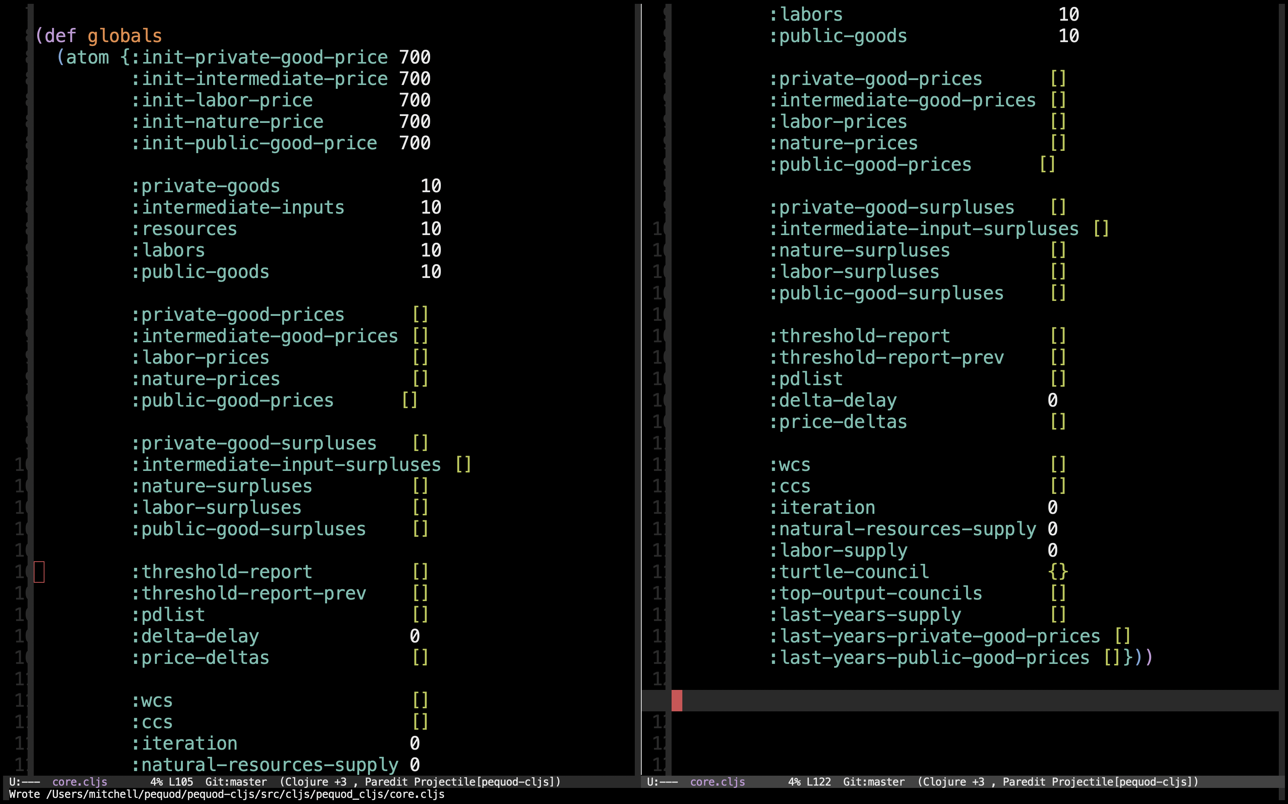
pequod-cljs

Slide 136
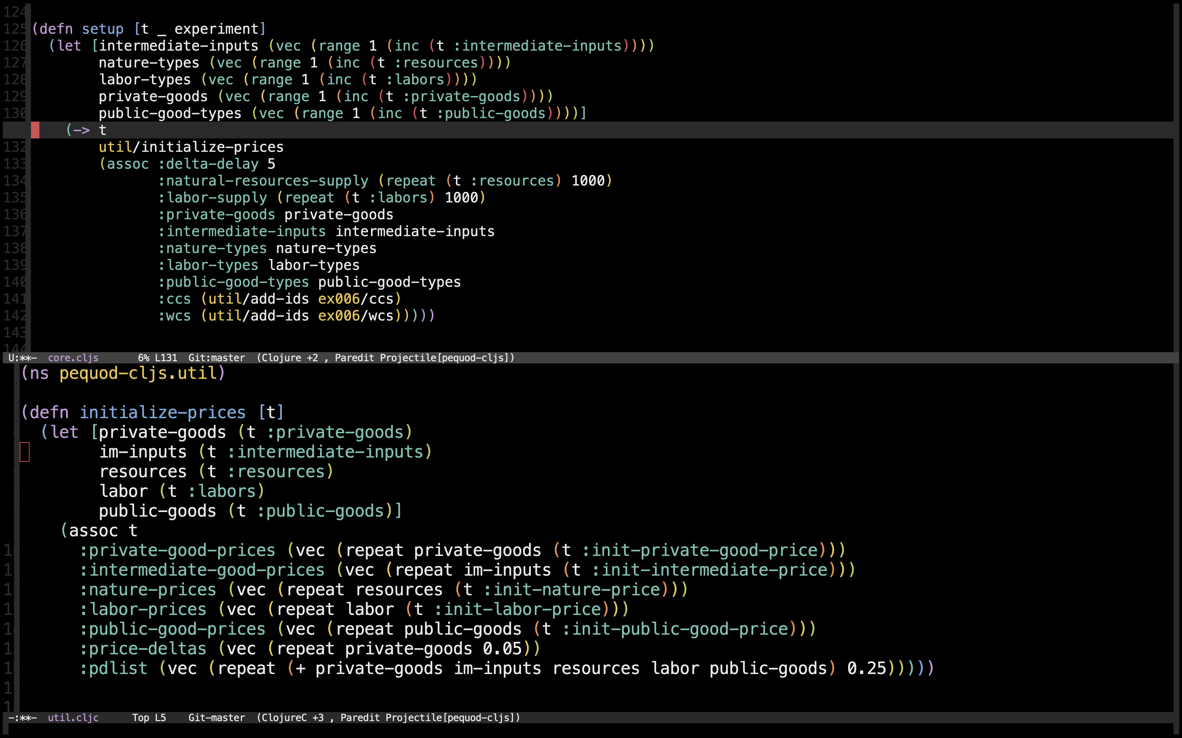
pequod-cljs

Slide 137
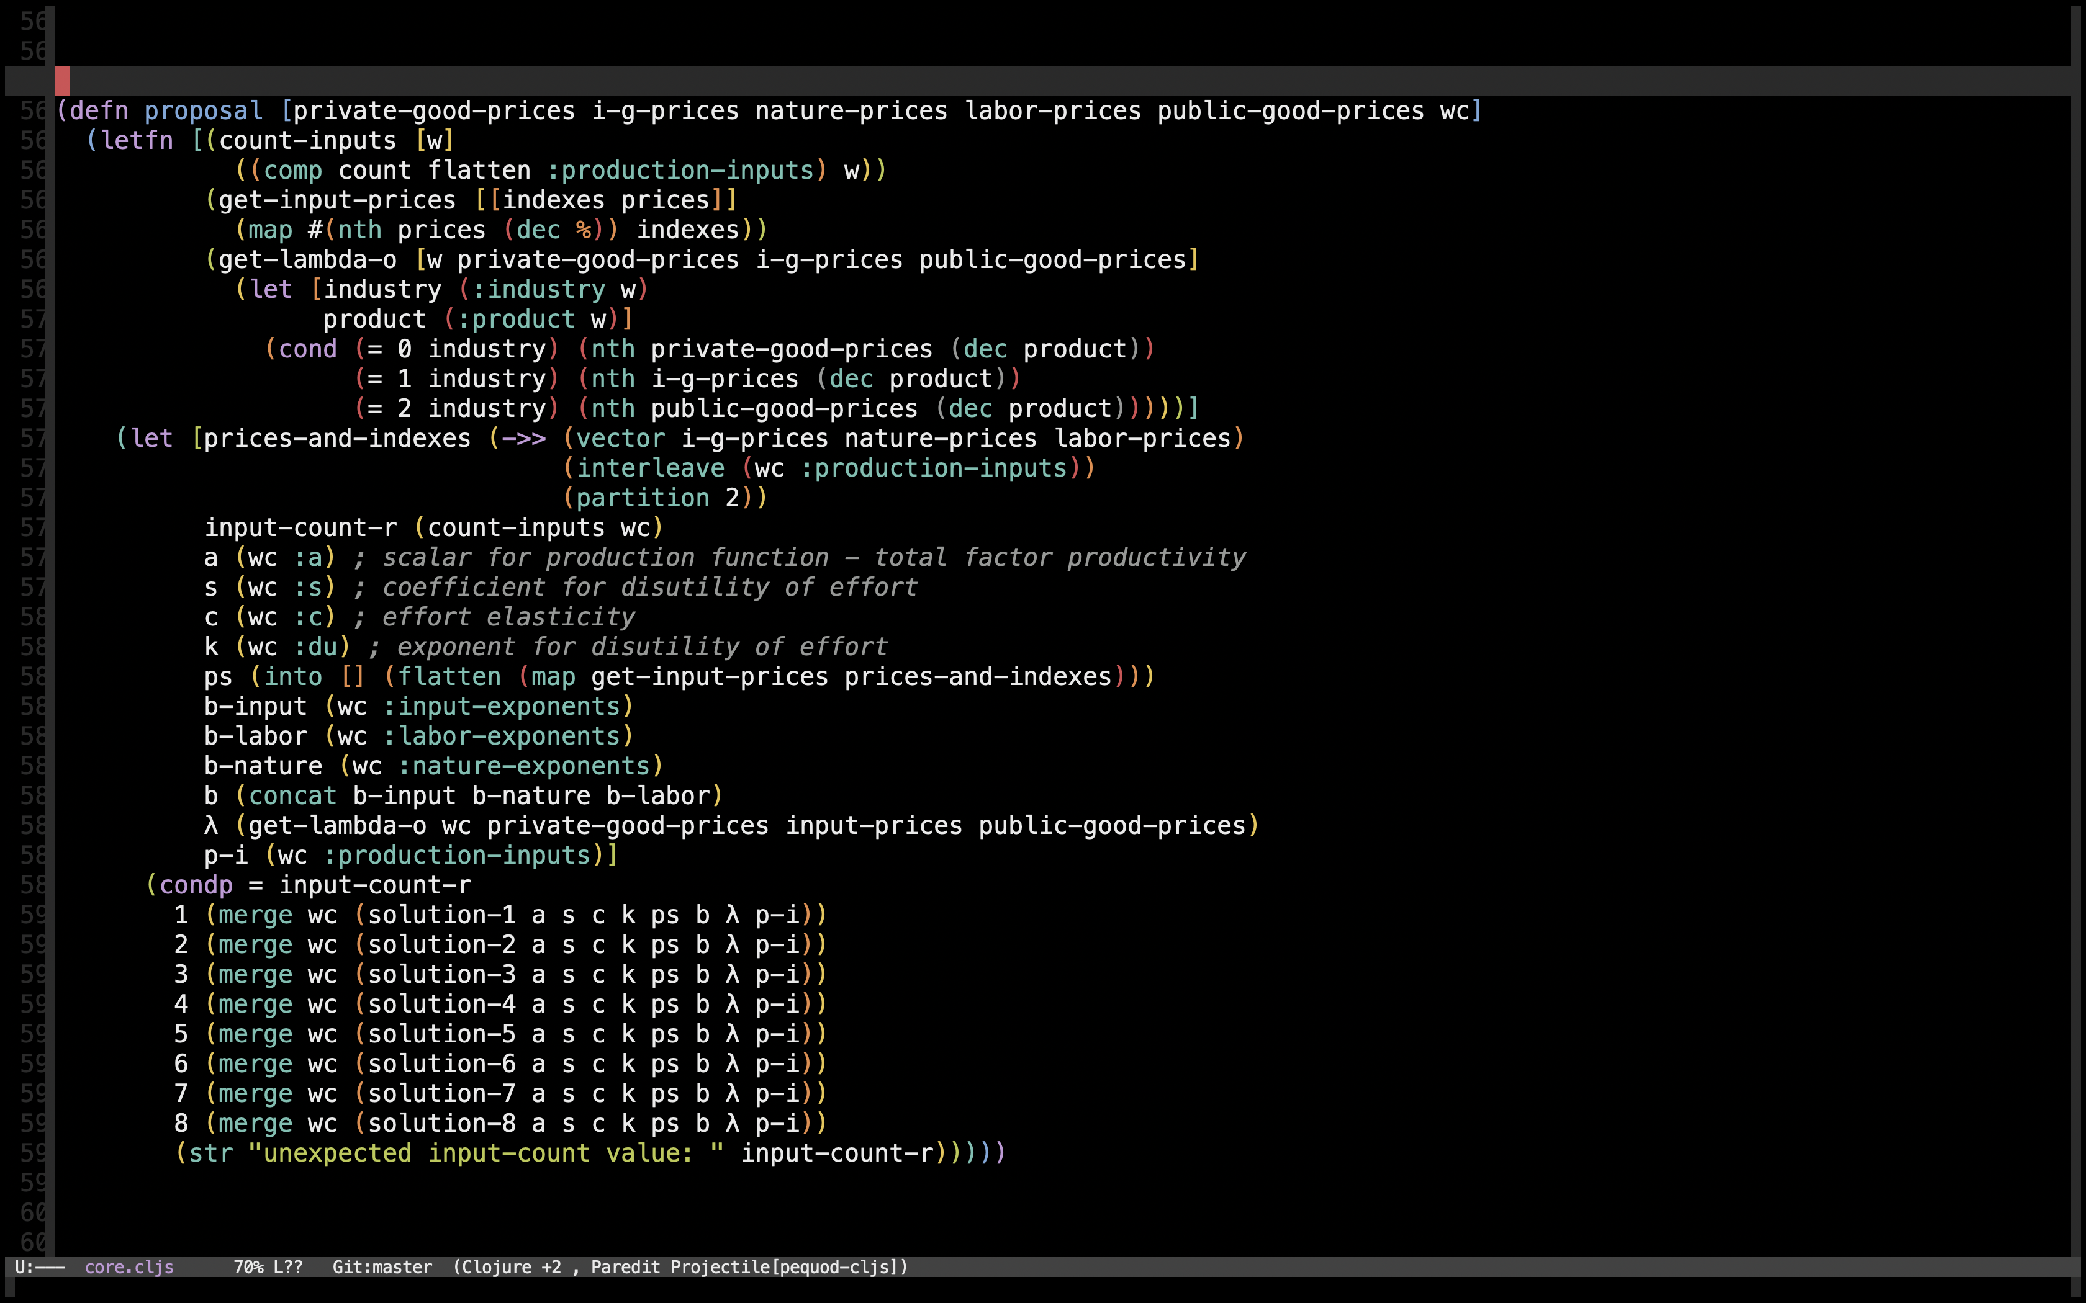
pequod-cljs

Slide 138
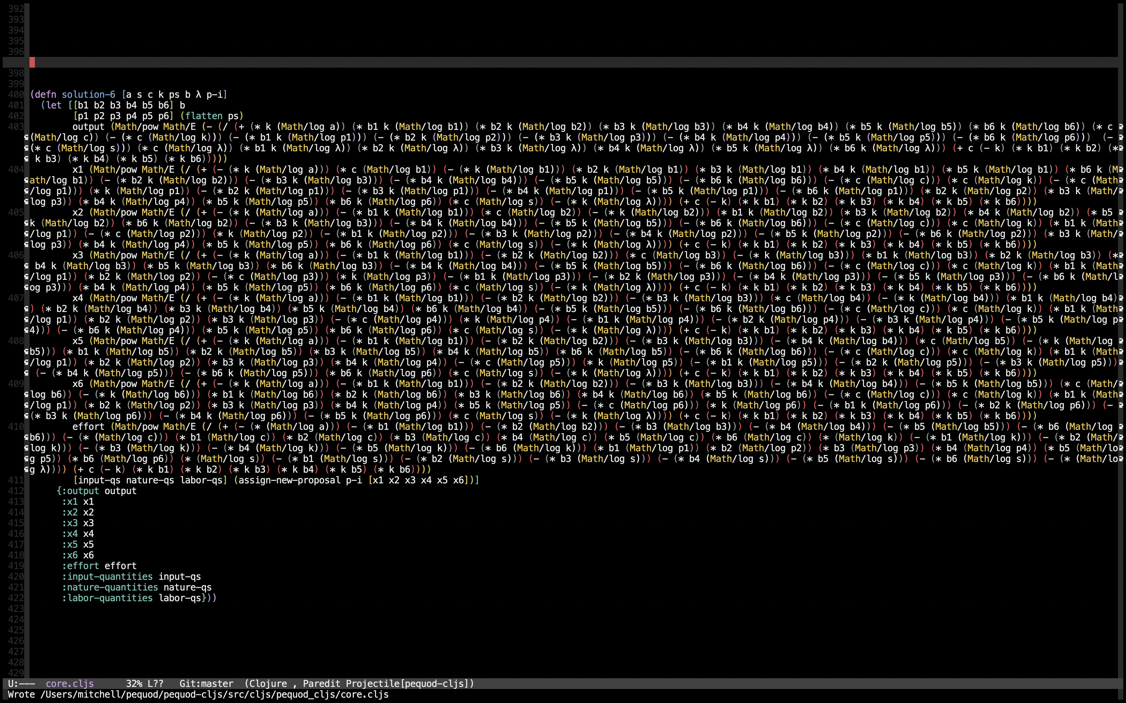
pequod-cljs

Slide 139
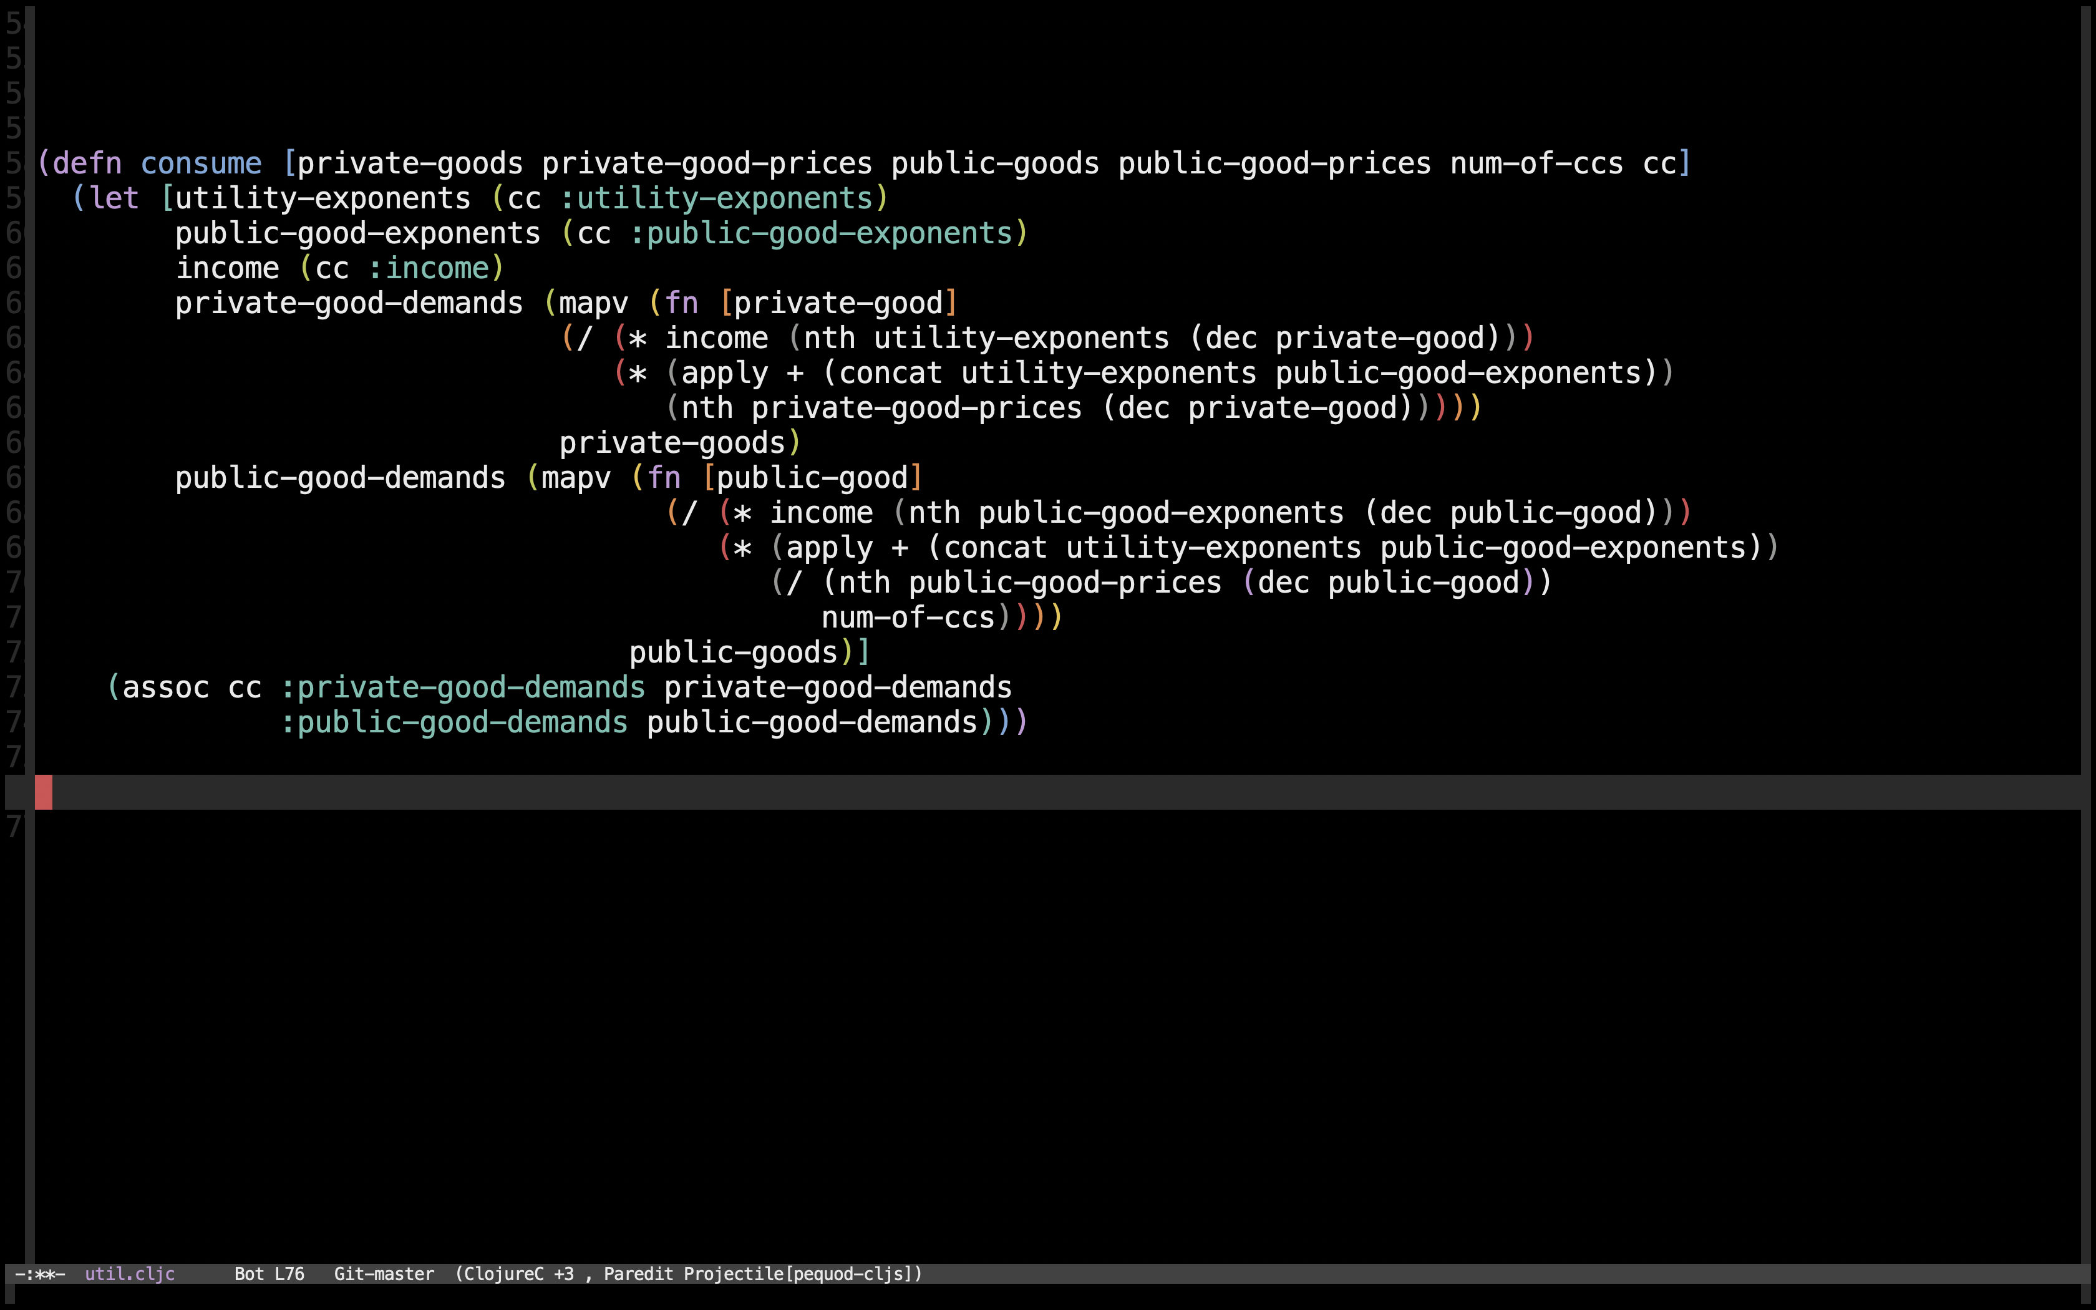
pequod-cljs

Slide 140
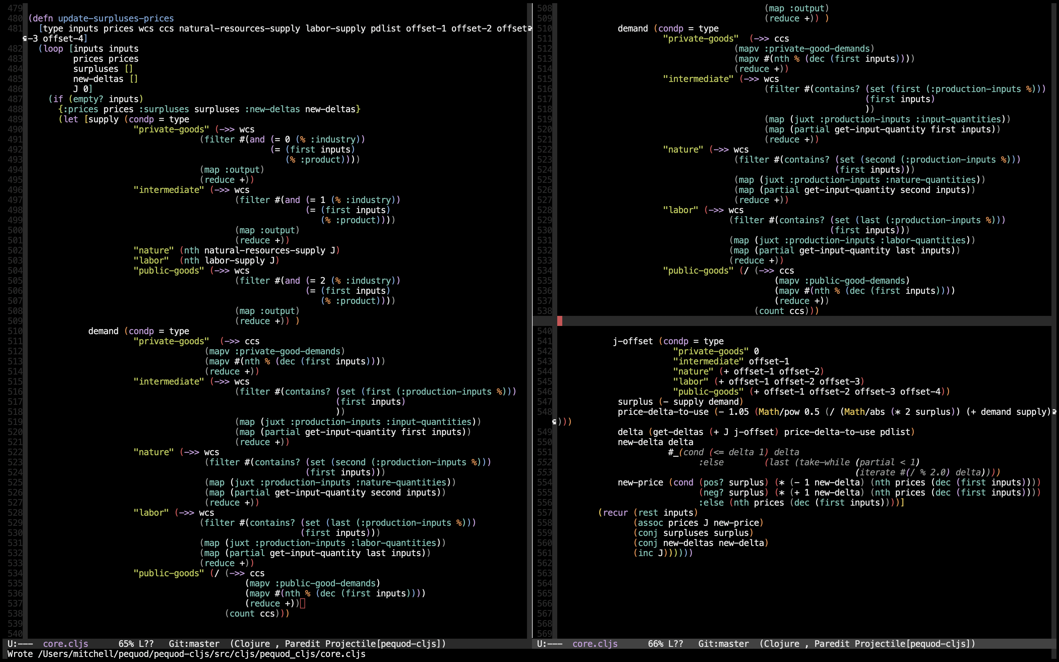
pequod-cljs

Slide 141
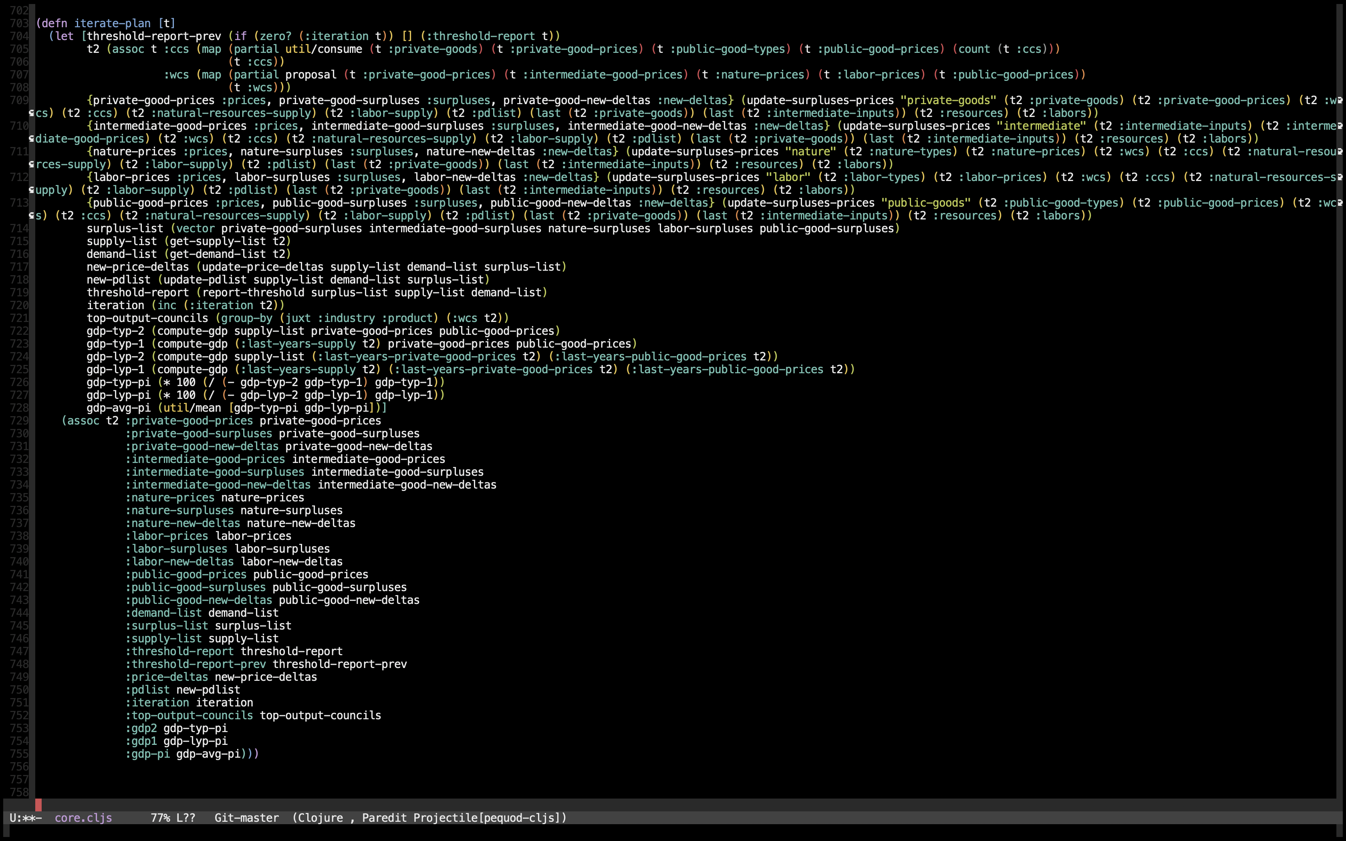
pequod-cljs

Slide 142
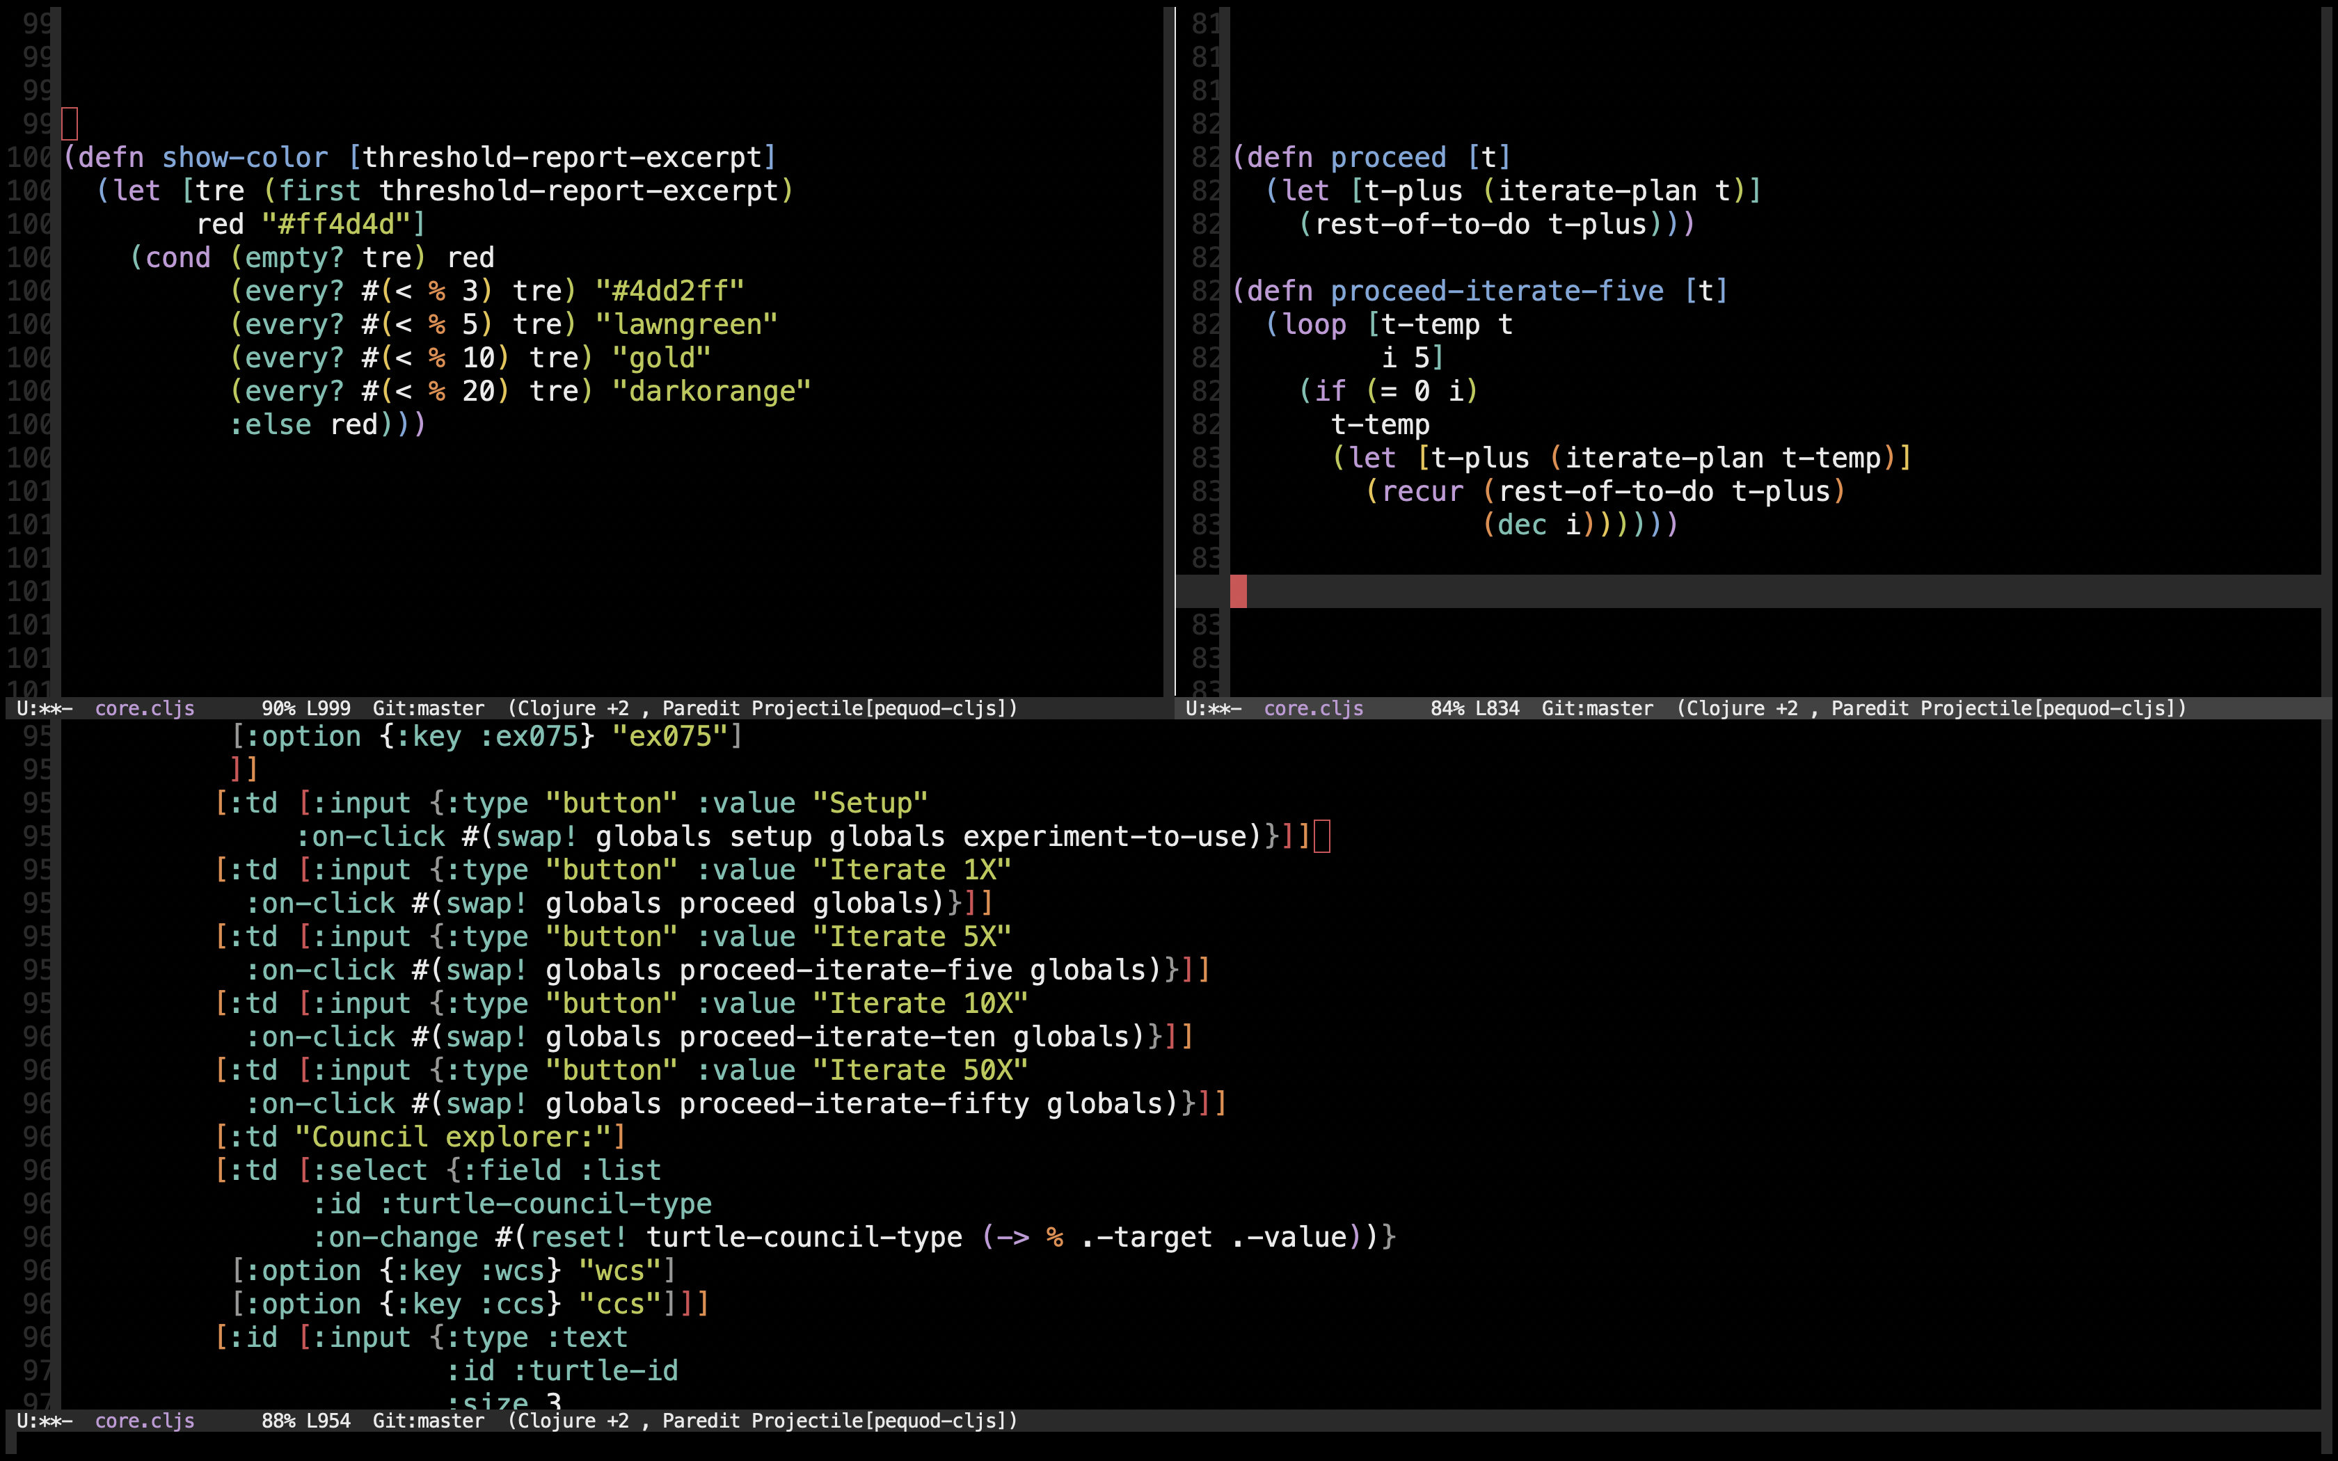
pequod-cljs

Slide 143
pequod-cljs
[demonstration]

Slide 144
pequod-cljs

Slide 145
pequod-cljs
10x

Slide 146
pequod-cljs
10x
40 experiments

Slide 147
OutlinE
A Clojure story
Economies and problems
A “third way”
Algorithm and code
pequod-cljs
pequod-clj
Future directions

Slide 148
pequod-clj

Slide 149
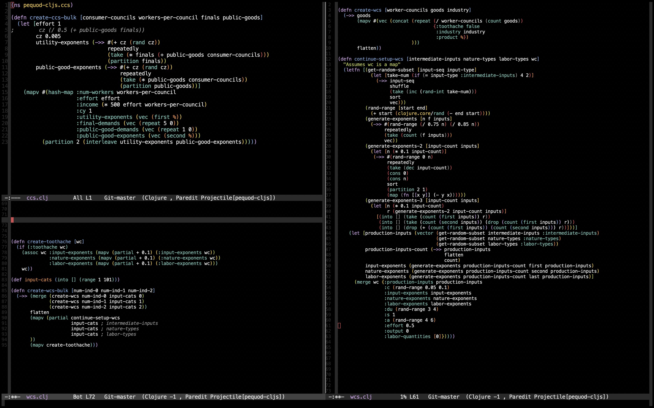
pequod-clj

Slide 150
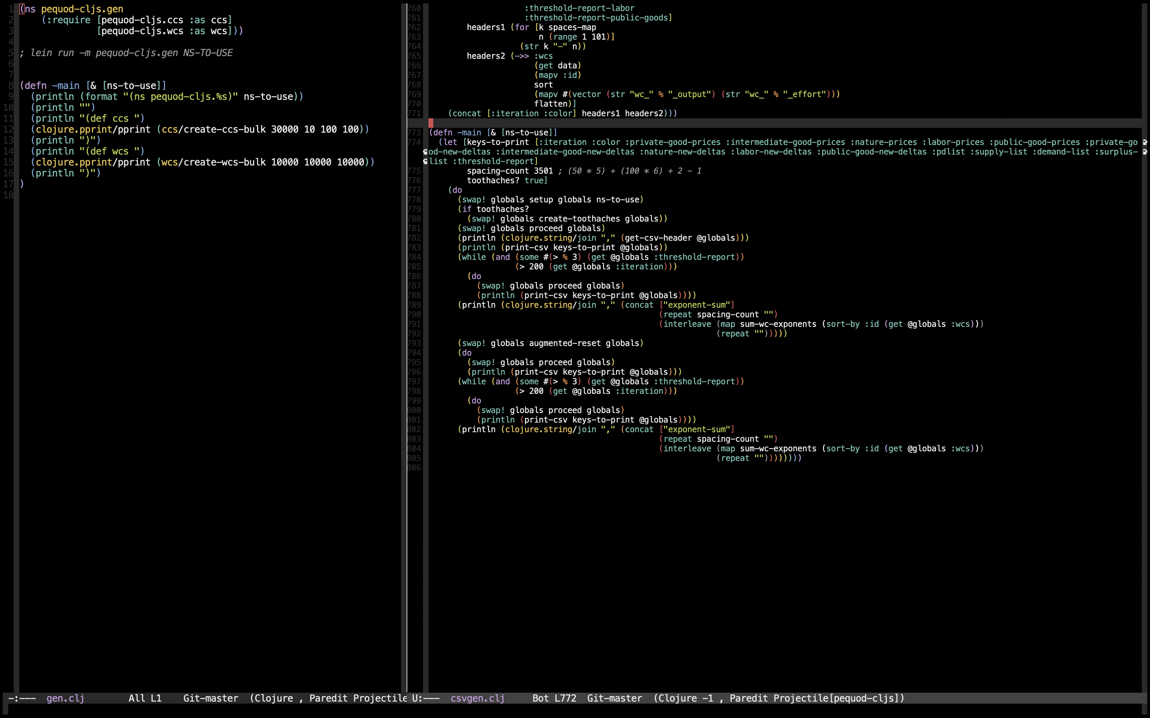
pequod-clj

Slide 151
pequod-clj
Findings:

Slide 152
pequod-clj
Findings:
To go to a 5% threshold from an arbitrary price vector: Avg. 11.85 iterations

Slide 153
pequod-clj
Findings:
To go to a 5% threshold from an arbitrary price vector: Avg. 11.85 iterations
To go to a 3% threshold from an arbitrary price vector: Avg. 19.2 iterations

Slide 154
pequod-clj
Findings:
To go to a 5% threshold from an arbitrary price vector: Avg. 11.85 iterations
To go to a 3% threshold from an arbitrary price vector: Avg. 19.2 iterations
To go from a 5% threshold from previous experiment’s price vector,
accounting for technology changes and consumer preferences’ changes:
Avg. 6.5 iterations, avg. GDP percentage increase of 2.446%

Slide 155
pequod-clj
Findings:
To go to a 5% threshold from an arbitrary price vector: Avg. 11.85 iterations
To go to a 3% threshold from an arbitrary price vector: Avg. 19.2 iterations
To go from a 5% threshold from previous experiment’s price vector,
accounting for technology changes and consumer preferences’ changes:
Avg. 6.5 iterations, avg. GDP percentage increase of 2.446%
Increasing returns to scale: Avg. 6.25 iterations, avg. GDP percentage
increase of 1.859%

Slide 156
pequod-clj

Slide 157
OutlinE
A Clojure story
Economies and problems
A “third way”
Algorithm and code
pequod-cljs
pequod-clj
Future directions

Slide 158
Future directions

Slide 159
Future directions
Code

Slide 160
Future directions
Code
Research

Slide 161
Future directions
Code
Research
New projects

Slide 162
Future directions
Code
Research
New projects
Future / past

Slide 163
Future directions
Code:

Slide 164
Future directions
Code:
More automated tests

Slide 165
Future directions
Code:
More automated tests
More code consolidation

Slide 166
Future directions
Code:
More automated tests
More code consolidation
More “Clojurey” code

Slide 167
Future directions
Code:
More automated tests
More code consolidation
More “Clojurey” code
No atoms

Slide 168
Future directions
Code:
More automated tests
More code consolidation
More “Clojurey” code
No atoms
Research kit?

Slide 169
Future directions
Research:

Slide 170
Future directions
Research:
New functions besides Cobb Douglas

Slide 171
Future directions
Research:
New functions besides Cobb Douglas
Search for improved price adjustment algorithms

Slide 172
Future directions
Research:
New functions besides Cobb Douglas
Search for improved price adjustment algorithms
More robustness testing

Slide 173
Future directions
Research:
New functions besides Cobb Douglas
Search for improved price adjustment algorithms
More robustness testing
Human intervention research

Slide 174
Future directions
Research:
New functions besides Cobb Douglas
Search for improved price adjustment algorithms
More robustness testing
Human intervention research
Environment impacts (“pollutants”)

Slide 175
Future directions
New projects:

Slide 176
Future directions
New projects:
Educational tools

Slide 177
Future directions
New projects:
Educational tools
Detailed simulations

Slide 178
Future directions
New projects:
Educational tools
Detailed simulations
Games

Slide 179
Future directions
New projects:
Educational tools
Detailed simulations
Games
Real life implementation

Slide 180
Future directions
New projects:
Educational tools
Detailed simulations
Games
Real life implementation
Application of these ideas for other uses

Slide 181
Future directions
Future / past:

Slide 182
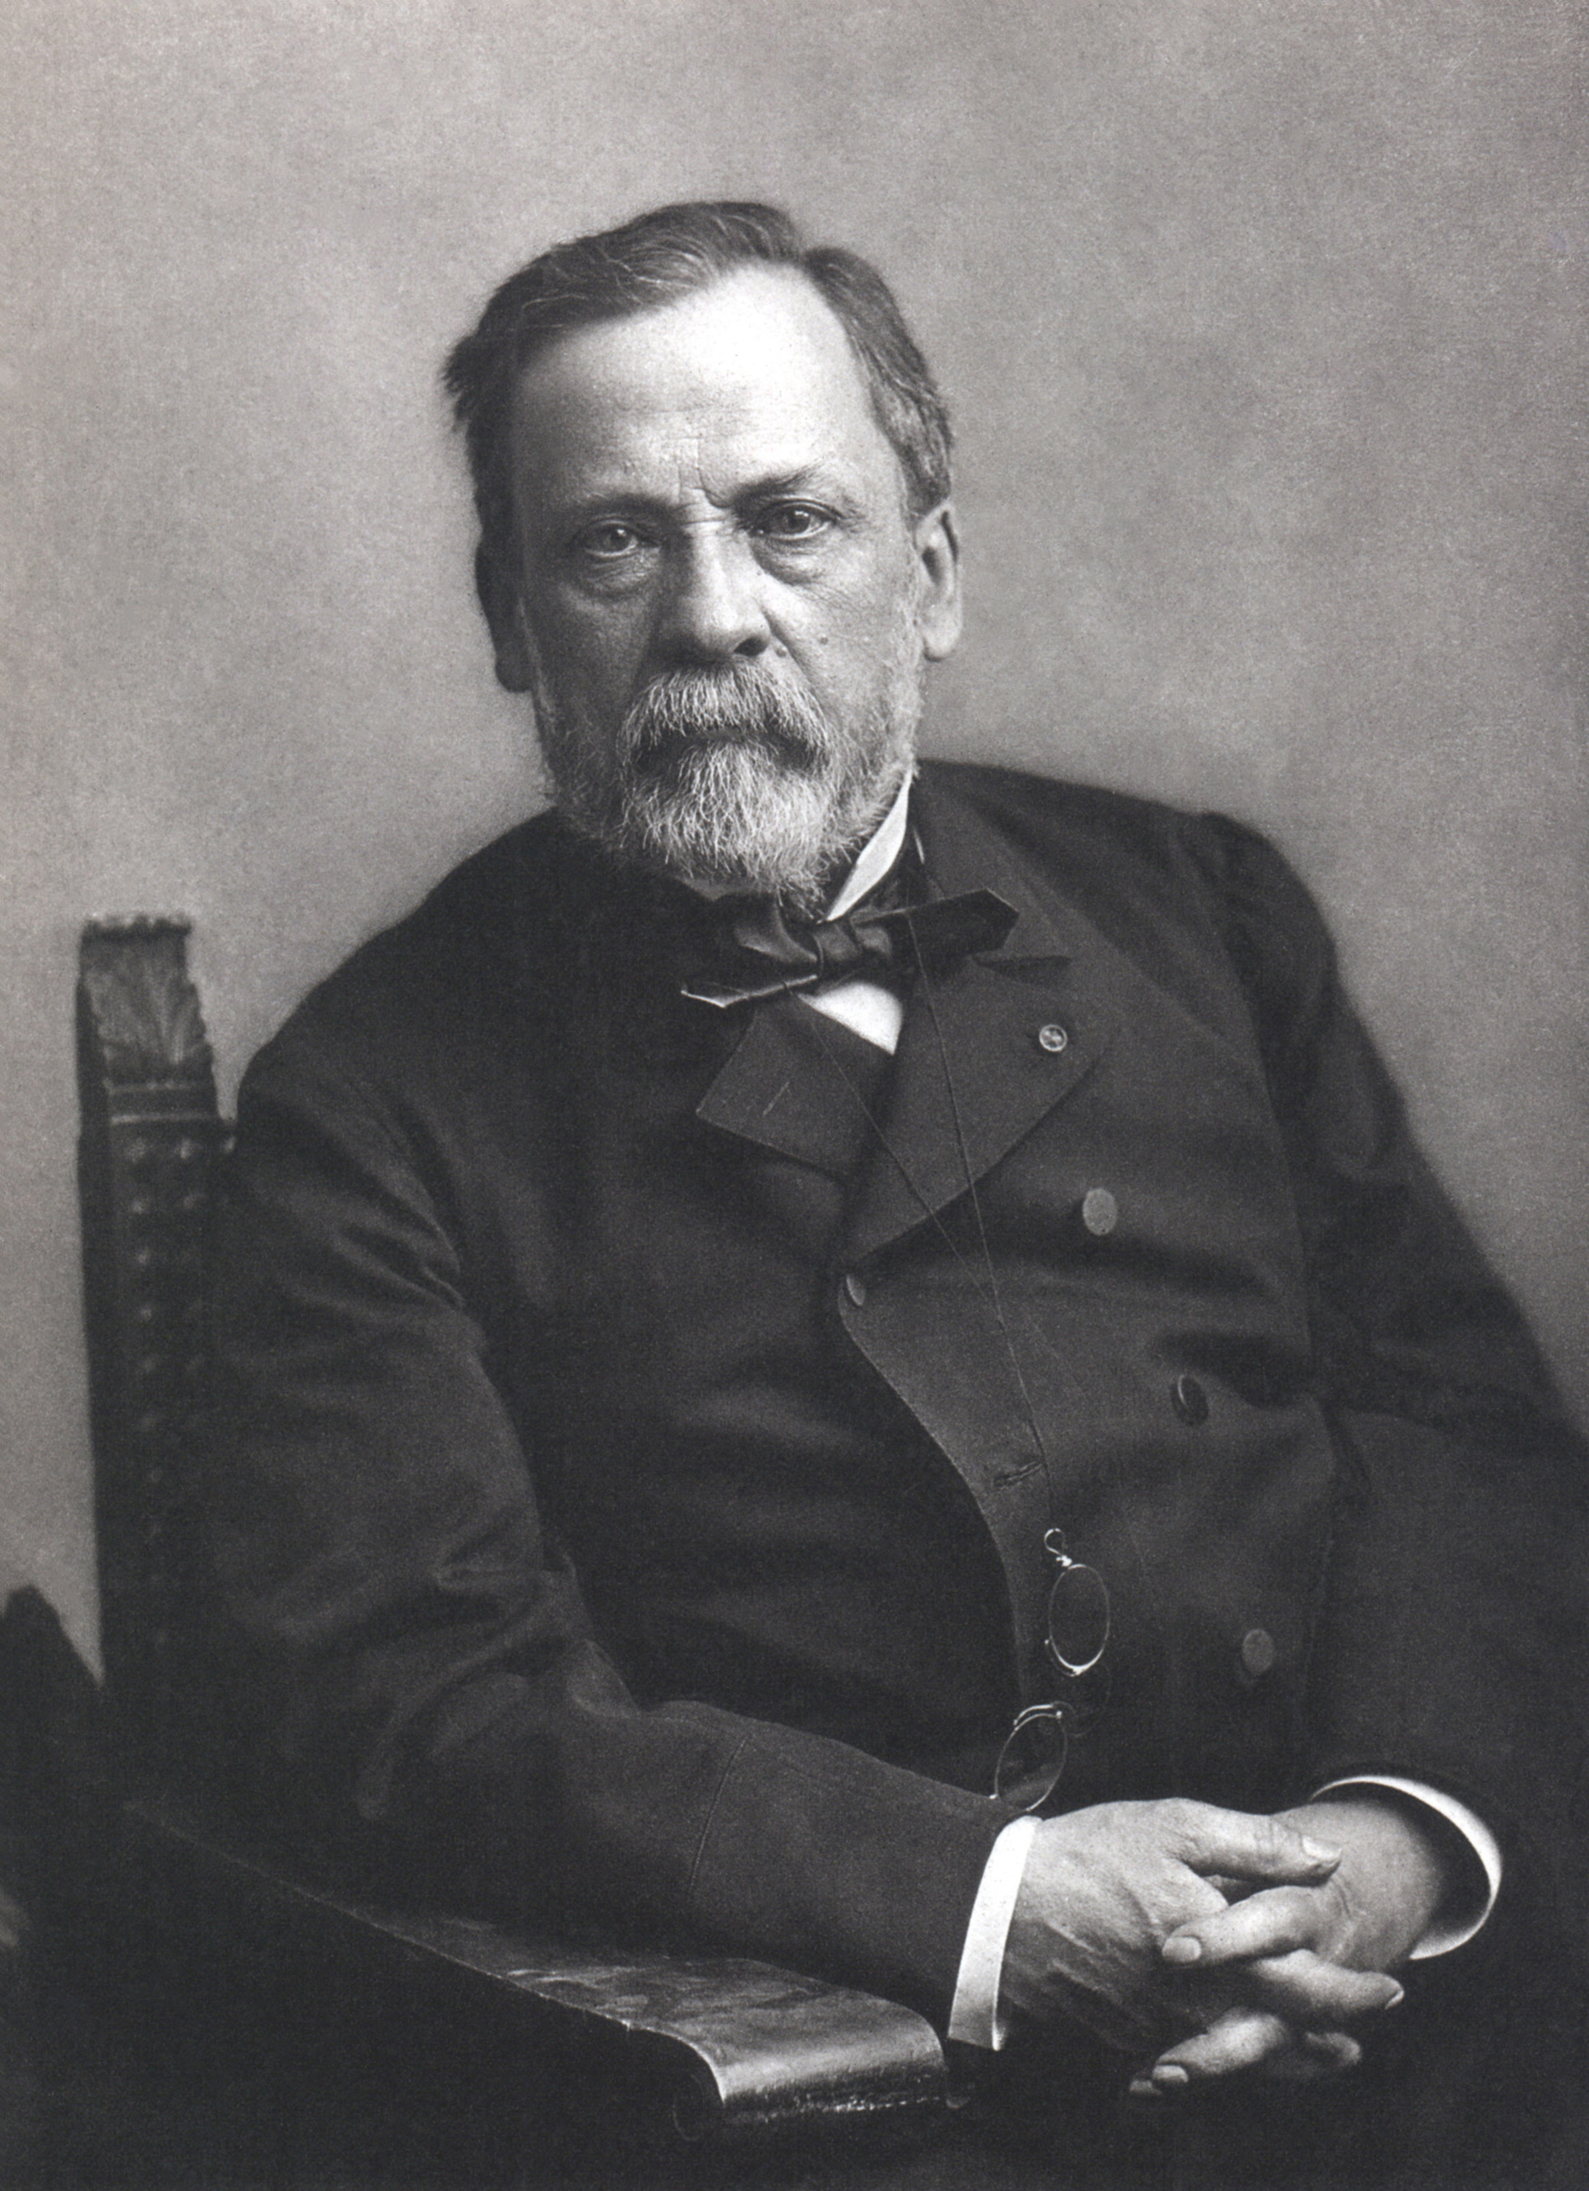
Future directions
Future / past:

Slide 183
Future directions
Future / past:
Louis Pasteur

Slide 184
Future directions
Future / past:
Pasteurization (for wine) patented: 1865

Slide 185
Future directions
Future / past:
Pasteurization (for wine) patented: 1865
Chicago mandates milk pasteurization:

Slide 186
Future directions
Future / past:
Pasteurization (for wine) patented: 1865
Chicago mandates milk pasteurization: 1909

Slide 187
Future directions
Future / past:
Pasteurization (for wine) patented: 1865
Chicago mandates milk pasteurization: 1909
Consumers, producers said no

Slide 188
Future directions
Future / past:
Pasteurization (for wine) patented: 1865
Chicago mandates milk pasteurization: 1909
Consumers, producers said no
Nathan Strauss lost two sons, campaigned

Slide 189
Future directions
Future / past:
Pasteurization (for wine) patented: 1865
Chicago mandates milk pasteurization: 1909
Consumers, producers said no
Nathan Strauss lost two sons, campaigned
Milk lab (1892), pasteurized milk for orphans

Slide 190
Future directions
Future / past:
1991, 2021

Slide 191
Future directions
Future / past:
1991, 2021
Does it work?

Slide 192
Future directions
Future / past:
1991, 2021
Does it work?
Some evidentiary support

Slide 193
Future directions
Future / past:
1991, 2021
Does it work?
Some evidentiary support
Things take time (“incrementalism”)

Slide 194
Future directions
Future / past:
1991, 2021
Does it work?
Some evidentiary support
Things take time (“incrementalism”)
Critical juncture theory

Slide 195
Future directions
Future / past:
1991, 2021
Does it work?
Some evidentiary support
Things take time (“incrementalism”)
Critical juncture theory
Berlin Wall, 1987

Slide 196
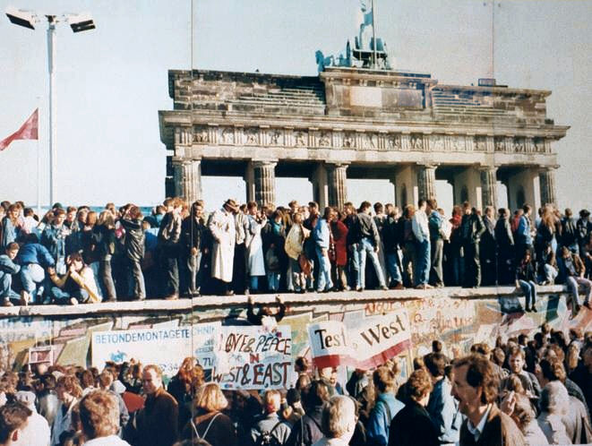
Future directions
Future / past:
1991, 2021
Does it work?
Some evidentiary support
Things take time (“incrementalism”)
Critical juncture theory
Berlin Wall, 1987
November 9, 1989

Slide 197
OutlinE
A Clojure story
Economies and problems
A “third way”
Algorithm and code
pequod-cljs
pequod-clj
Future directions

Slide 198
LINKS
https://github.com/msszczep/pequod-cljs
http://www.szcz.org/depexperiments/
https://github.com/msszczep/pequod2
https://participatoryeconomy.org

